Slide 1
Module 2: Coupling in the Physical Domain

Slide 2
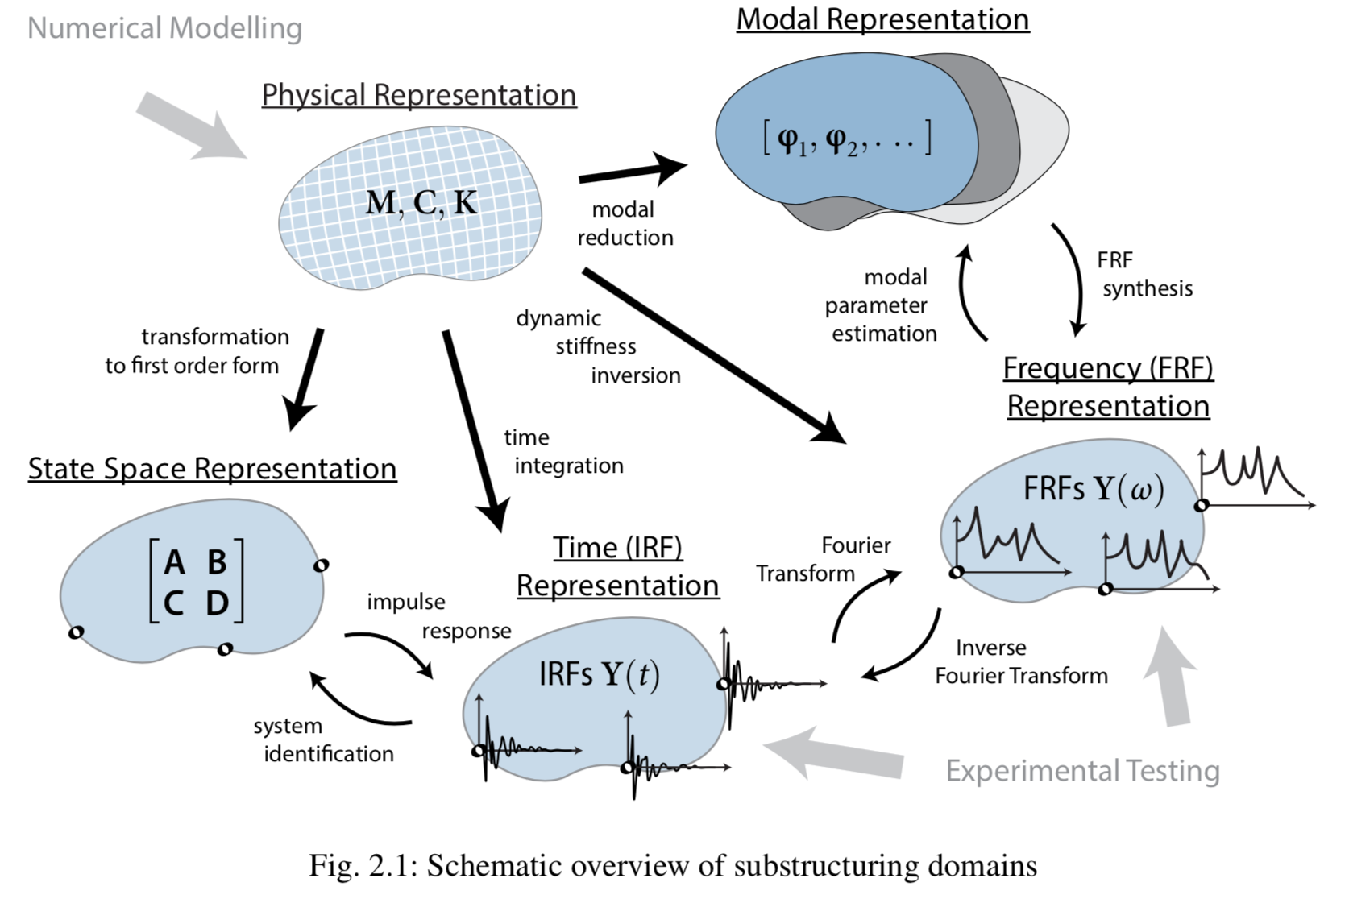
Different Domains to apply substructuring in
Depending on how
the dynamics of the
components are
described

Slide 3
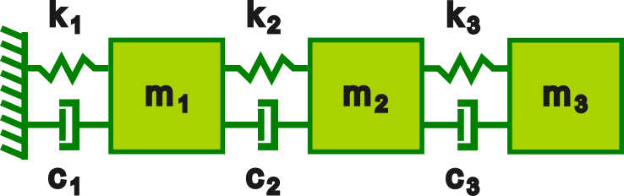
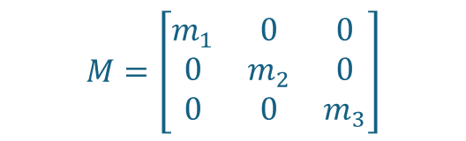




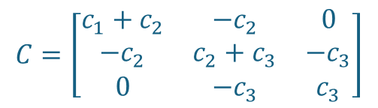

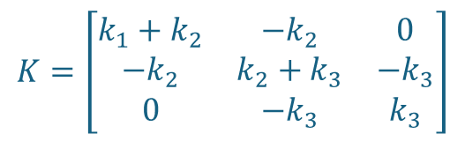

A single structure
Let’s have a look at a three degree-of-freedom discrete viscously damped structure that will later be assembled with other structures.
At the moment, the structure does not “know” anything about other structures.
The structure consists of discrete masses, $m_{1},m_{2}$and $m_{3}$, dampers, with coefficients $c_{1},c_{2}$and $c_{3}$, and springs, with stiffnesses $k_{1},k_{2}$and $k_{3}$ and it is excited by the external forces $f_{1},f_{2}$and $f$ . The response are $x_{1},x_{2}$and $x_{3}$.
$$M=\left[\begin{matrix}m_{1} & 0 & 0 \\ 0 & m_{2} & 0 \\ 0 & 0 & m_{3}\end{matrix}\right]$$
$$C=\left[\begin{matrix}c_{1}+c_{2} & −c_{2} & 0 \\ {−c}_{2} & c_{2}+c_{3} & {−c}_{3} \\ 0 & {−c}_{3} & c_{3}\end{matrix}\right]$$
$$K=\left[\begin{matrix}k_{1}+k_{2} & {−k}_{2} & 0 \\ −k_{2} & k_{2}+k_{3} & −k_{3} \\ 0 & −k_{3} & k_{3}\end{matrix}\right]$$
$$X=\left\{\begin{matrix}x_{1} \\ x_{2} \\ x_{3}\end{matrix}\right\}$$
$$F=\left\{\begin{matrix}f_{1} \\ f_{2} \\ f_{3}\end{matrix}\right\}$$
$x_{1}$, $f_{1}$
$x_{2}$, $f_{2}$
$x_{3}$, $f_{3}$

Slide 4

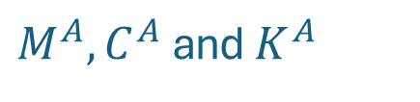
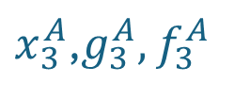
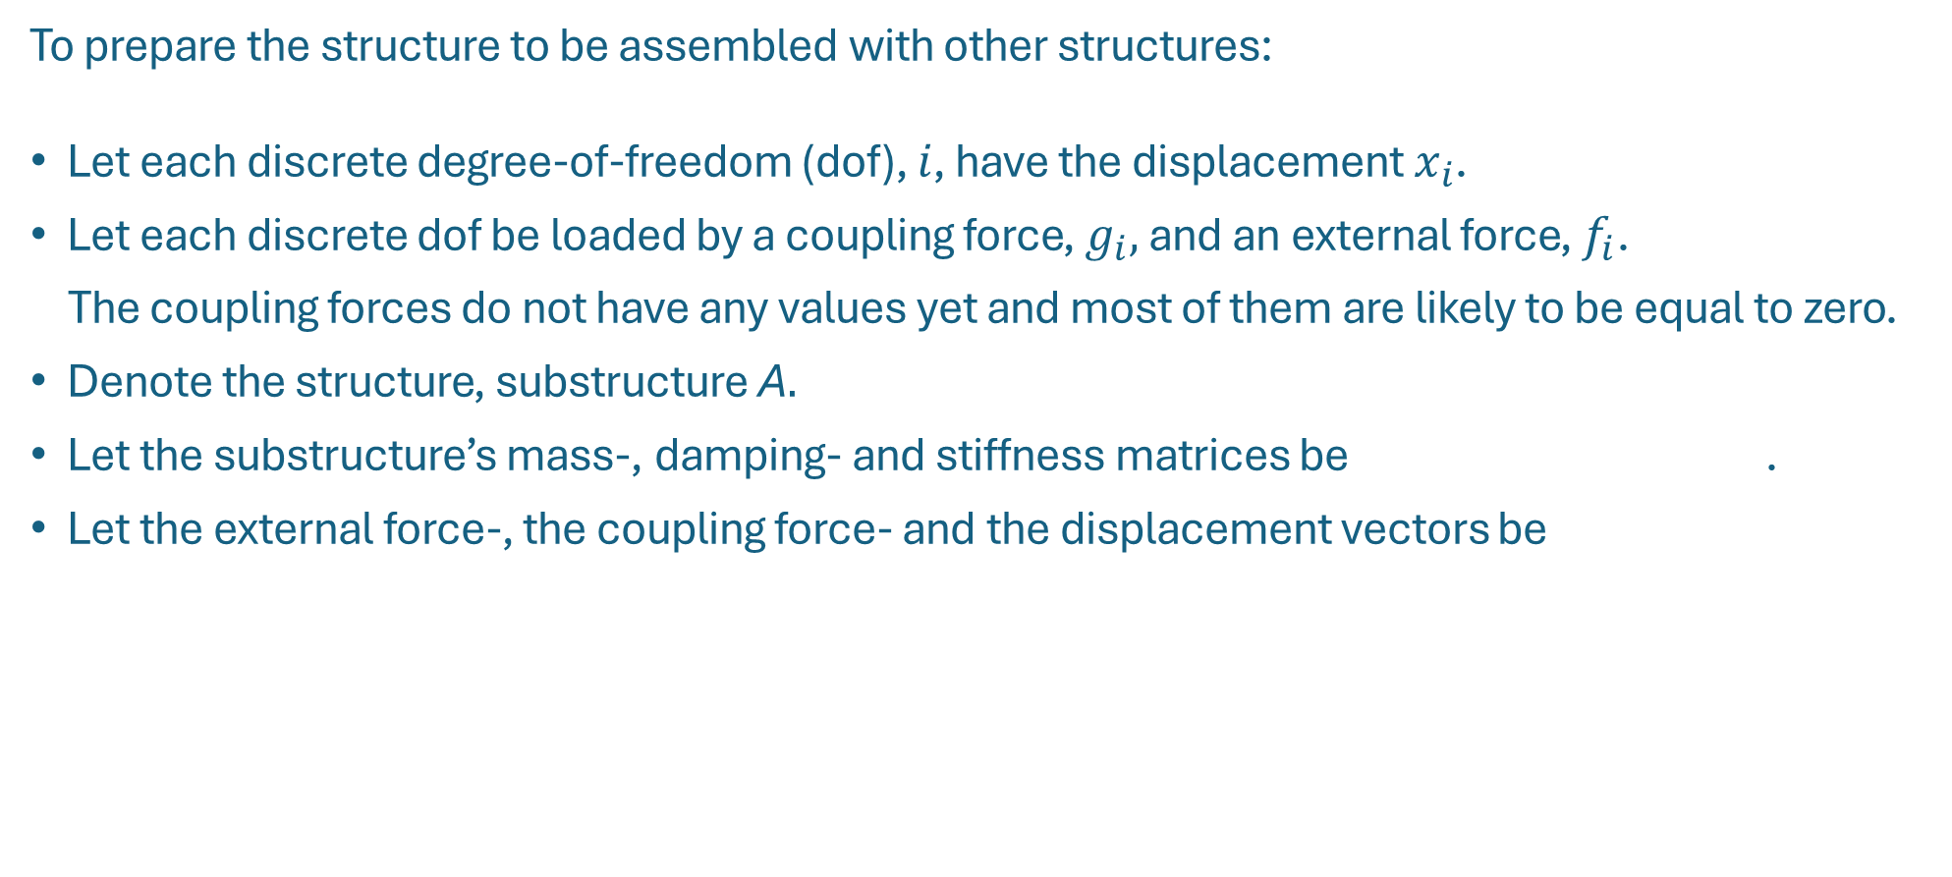
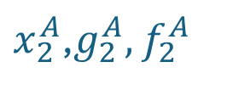



Prepare for assembling
To prepare the structure to be assembled with other structures:
Let each discrete degree-of-freedom (dof), $i$, have the displacement $x_{i}$.
Let each discrete dof be loaded by a coupling force, $g_{i},$ and an external force, $f_{i}$.
The coupling forces do not have any values yet and most of them are likely to be equal to zero.
Denote the structure, substructure A$.$
Let the substructure’s mass-, damping- and stiffness matrices be .
Let the external force-, the coupling force- and the displacement vectors be
$M^{A},C^{A}$ and $K^{A}$
$x_{1}^{A}$,$g_{1}^{A},$ $f_{1}^{A}$
$x_{2}^{A}$,$g_{2}^{A},$ $f_{2}^{A}$
$x_{3}^{A}$,$g_{3}^{A},$ $f_{3}^{A}$
$$F^{A}=\left\{\begin{matrix}f_{1}^{A} \\ f_{2}^{A} \\ f_{3}^{A}\end{matrix}\right\}$$
$$G^{A}=\left\{\begin{matrix}g_{1}^{A} \\ g_{2}^{A} \\ g_{3}^{A}\end{matrix}\right\}$$
$$X^{A}=\left\{\begin{matrix}x_{1}^{A} \\ x_{2}^{A} \\ x_{3}^{A}\end{matrix}\right\}$$
,
and

Slide 5
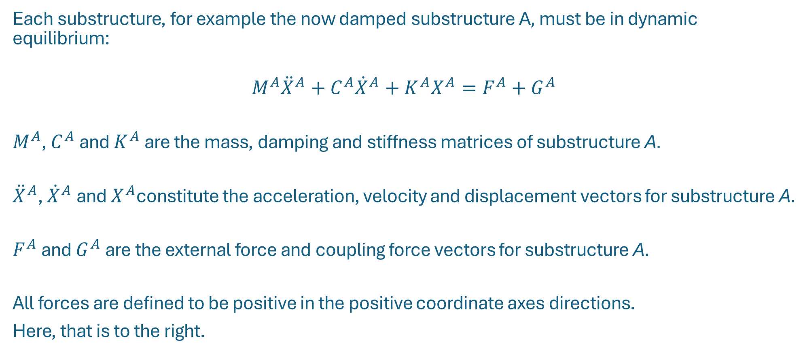
Coupling in the physical domain
Each substructure, for example the now damped substructure A$,$must be in dynamic equilibrium:
$$M^{A}{\ddot{X}}^{A}+C^{A}{\dot{X}}^{A}+K^{A}X^{A}=F^{A}+G^{A}$$
$M^{A}$, $C^{A}$ and $K^{A}$ are the mass, damping and stiffness matrices of substructure A$.$
${\ddot{X}}^{A}$, ${\dot{X}}^{A}$ and $X^{A}$constitute the acceleration, velocity and displacement vectors for substructure A$.$
$F^{A}$ and $G^{A}$ are the external force and coupling force vectors for substructure A$.$
All forces are defined to be positive in the positive coordinate axes directions.
Here, that is to the right.

Slide 6
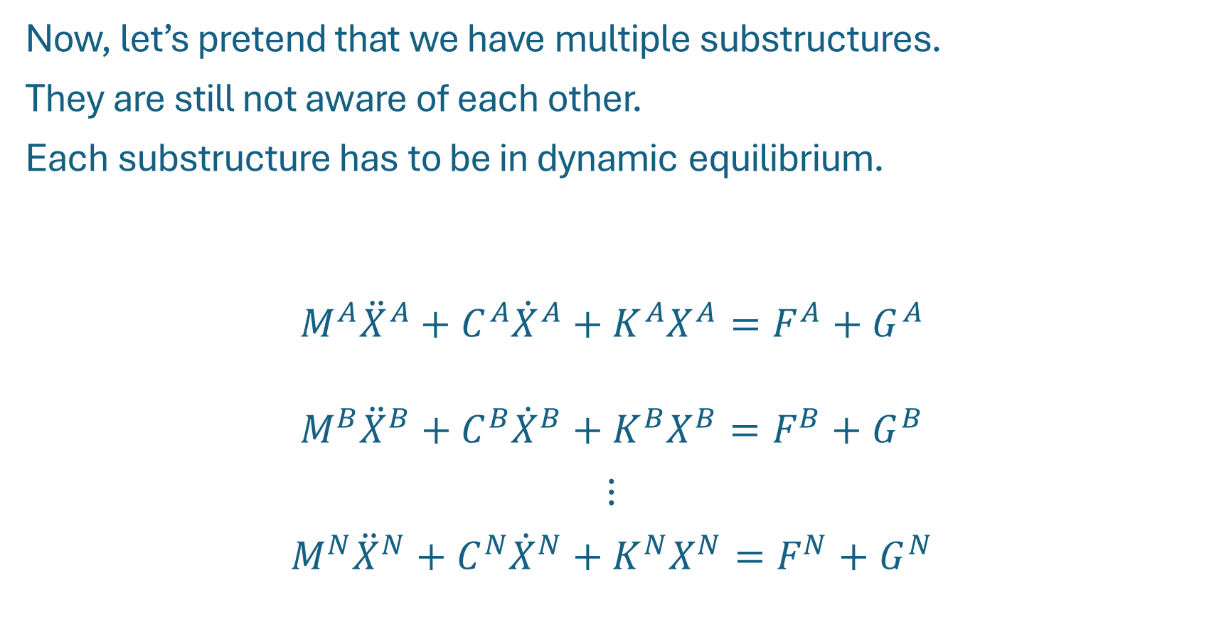
Multiple substructures
Now, let’s pretend that we have multiple substructures.
They are still not aware of each other.
Each substructure has to be in dynamic equilibrium.
$$M^{A}{\ddot{X}}^{A}+C^{A}{\dot{X}}^{A}+K^{A}X^{A}=F^{A}+G^{A}$$
$$M^{B}{\ddot{X}}^{B}+C^{B}{\dot{X}}^{B}+K^{B}X^{B}=F^{B}+G^{B}$$
$$⋮$$
$$M^{N}{\ddot{X}}^{N}+C^{N}{\dot{X}}^{N}+K^{N}X^{N}=F^{N}+G^{N}$$

Slide 7









Block diagonal form
Let us put the n equations of motion in block diagonal form.
Then: Note that the substructures still do not know anything of each others presence
$$M≜\left[\begin{matrix}M^{A} & ⋯ & 0 \\ ⋮ & ⋱ & ⋮ \\ 0 & ⋯ & M^{N}\end{matrix}\right]$$
C$≜\left[\begin{matrix}C^{A} & ⋯ & 0 \\ ⋮ & ⋱ & ⋮ \\ 0 & ⋯ & C^{N}\end{matrix}\right]$
K$≜\left[\begin{matrix}K^{A} & ⋯ & 0 \\ ⋮ & ⋱ & ⋮ \\ 0 & ⋯ & K^{N}\end{matrix}\right]$
$$\ddot{X}≜ \left\{\begin{matrix}{\ddot{X}}^{A} \\ ⋮ \\ {\ddot{X}}^{N}\end{matrix}\right\}$$
$$\dot{X} ≜ \left\{\begin{matrix}{\dot{X}}^{A} \\ ⋮ \\ {\dot{X}}^{N}\end{matrix}\right\}$$
X$≜ \left\{\begin{matrix}X^{A} \\ ⋮ \\ X^{N}\end{matrix}\right\}$
F$≜ \left\{\begin{matrix}F^{A} \\ ⋮ \\ F^{N}\end{matrix}\right\}$
G$≜ \left\{\begin{matrix}G^{A} \\ ⋮ \\ G^{N}\end{matrix}\right\}$
$$M\ddot{X}+C\dot{X}+KX=F+G$$

Slide 8
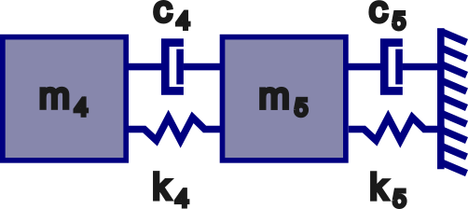
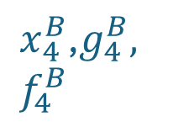

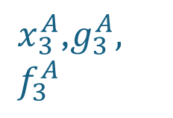
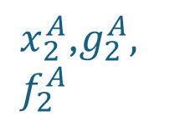
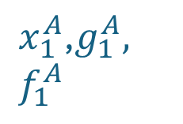
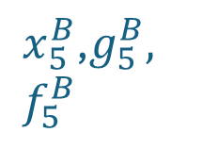
Compatibility
Now, we want two substructures to be rigidly coupled.
That requires compatibility. In the example,
it is required that $x_{3}^{A}=x_{4}^{B}.$That can be expressed as $x_{3}^{A}−x_{4}^{B}=0$.
System A
System B
$x_{1}^{A}$,$g_{1}^{A},$ $f_{1}^{A}$
$x_{2}^{A}$,$g_{2}^{A},$ $f_{2}^{A}$
$x_{3}^{A}$,$g_{3}^{A},$ $f_{3}^{A}$
$x_{4}^{B}$,$g_{4}^{B},$ $f_{4}^{B}$
$x_{5}^{B}$,$g_{5}^{B},$ $f_{5}^{B}$

Slide 9
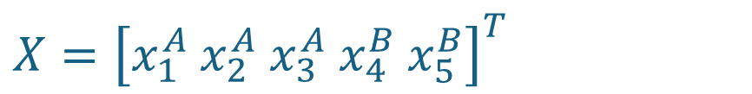
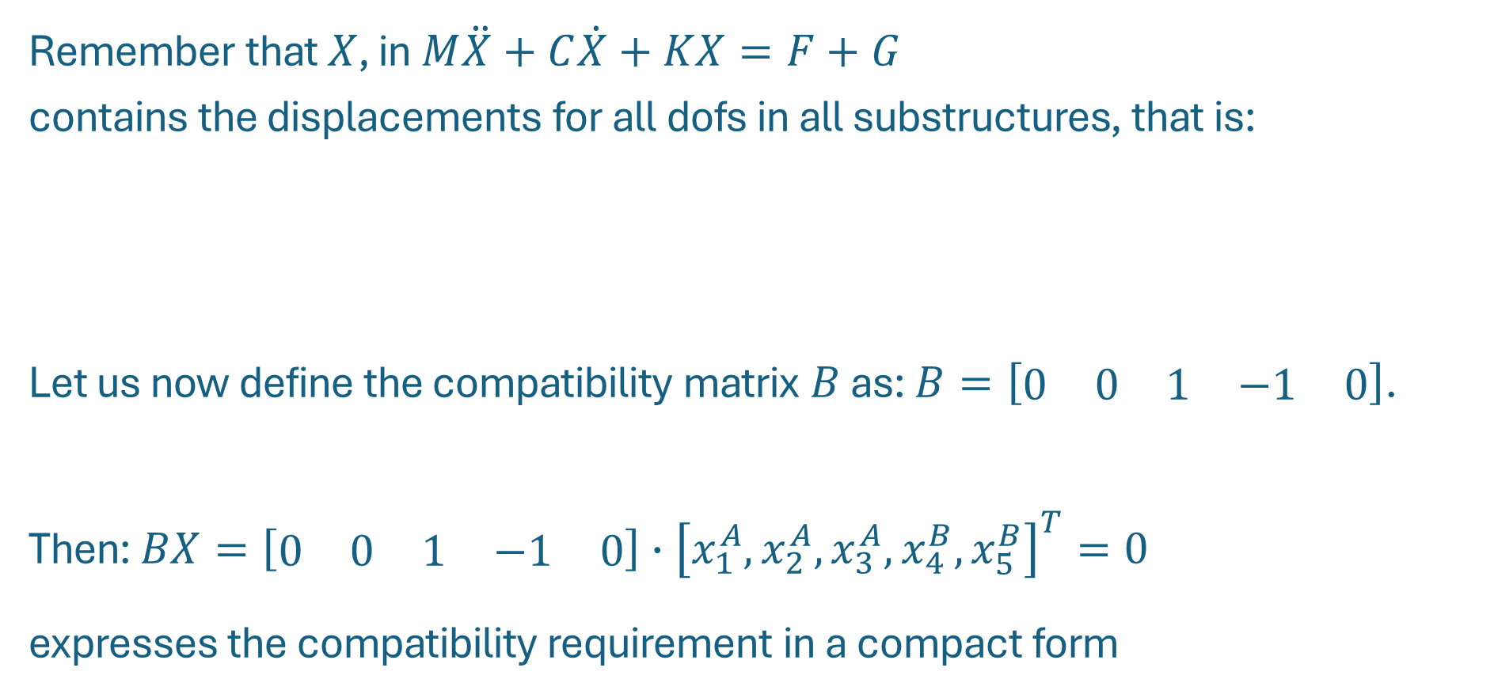
Compatibility
Remember that $X$, in$M\ddot{X}+C\dot{X}+KX=F+G$
contains the displacements for all dofs in all substructures, that is:
Let us now define the compatibility matrix $B$ as: $B=\left[\begin{matrix}\begin{matrix}0 & 0 & 1\end{matrix} & \begin{matrix}−1 & 0\end{matrix}\end{matrix}\right]$.
Then: $BX=\left[\begin{matrix}\begin{matrix}0 & 0 & 1\end{matrix} & \begin{matrix}−1 & 0\end{matrix}\end{matrix}\right]∙{\left[x_{1}^{A},x_{2}^{A}, x_{3}^{A},x_{4}^{B},x_{5}^{B}\right]}^{T}=0$
expresses the compatibility requirement in a compact form
$$X={\left[x_{1}^{A} x_{2}^{A} x_{3}^{A} x_{4}^{B} x_{5}^{B}\right]}^{T}$$

Slide 10
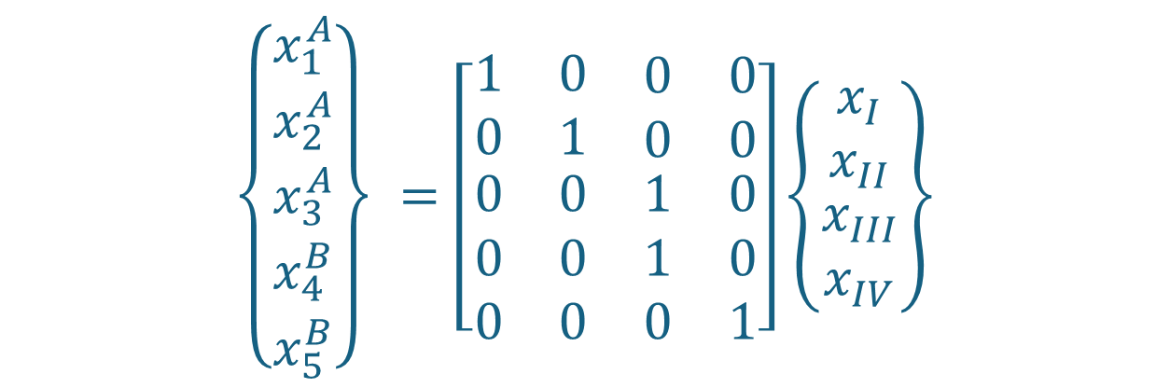
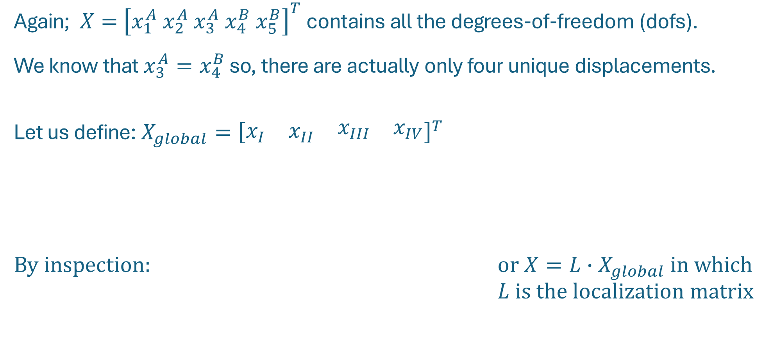
The localization matrix, L
Again;$X=$ ${\left[x_{1}^{A} x_{2}^{A} x_{3}^{A} x_{4}^{B} x_{5}^{B}\right]}^{T}$contains all the degrees-of-freedom (dofs).
We know that $x_{3}^{A}=x_{4}^{B}$ so, there are actually only four unique displacements.
Let us define: $X_{global}={\left[\begin{matrix}x_{I} & x_{II} & \begin{matrix}x_{III} & x_{IV}\end{matrix}\end{matrix}\right]}^{T}$
By inspection: or $X=L∙X_{global}$ in which $L$ is the localization matrix
$$\left\{\begin{matrix}x_{1}^{A} \\ \begin{matrix}x_{2}^{A} \\ x_{3}^{A} \\ x_{4}^{B}\end{matrix} \\ x_{5}^{B}\end{matrix}\right\} =\left[\begin{matrix}1 & 0 & \begin{matrix}0 & 0\end{matrix} \\ 0 & 1 & \begin{matrix}0 & 0\end{matrix} \\ \begin{matrix}0 \\ 0 \\ 0\end{matrix} & \begin{matrix}0 \\ 0 \\ 0\end{matrix} & \begin{matrix}\begin{matrix}1 & 0\end{matrix} \\ \begin{matrix}1 & 0\end{matrix} \\ \begin{matrix}0 & 1\end{matrix}\end{matrix}\end{matrix}\right]\left\{\begin{matrix}\begin{matrix}x_{I} \\ x_{II}\end{matrix} \\ x_{III} \\ x_{IV}\end{matrix}\right\}$$

Slide 11
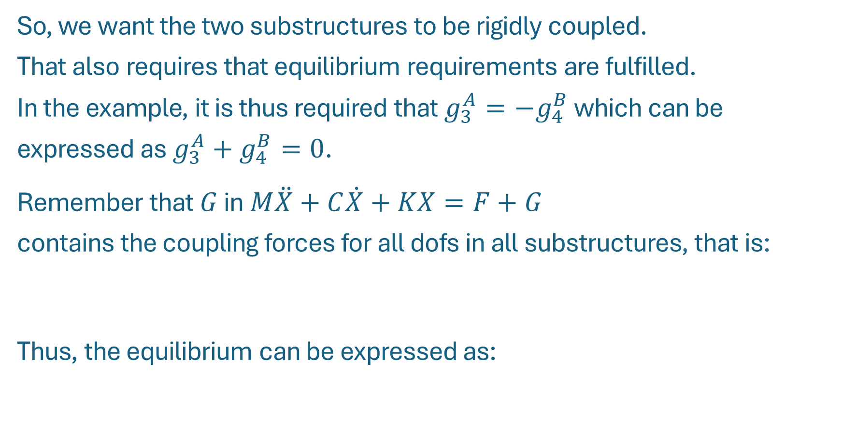

Equilibrium
So, we want the two substructures to be rigidly coupled.
That also requires that equilibrium requirements are fulfilled.
In the example, it is thus required that $g_{3}^{A}={−g}_{4}^{B}$ which can be
expressed as $g_{3}^{A}+g_{4}^{B}=0$.
Remember that $G$ in$M\ddot{X}+C\dot{X}+KX=F+G$
contains the coupling forces for all dofs in all substructures, that is:
Thus, the equilibrium can be expressed as:
$$G={\left[\begin{matrix}\begin{matrix}g_{1}^{A} & g_{2}^{A} & g_{3}^{A}\end{matrix} & \begin{matrix}g_{4}^{B} & g_{5}^{B}\end{matrix}\end{matrix}\right]}^{T}$$
$$\left[\begin{matrix}\begin{matrix}0 & 0 & 1\end{matrix} & \begin{matrix}1 & 0\end{matrix}\end{matrix}\right]∙G=0$$

Slide 12

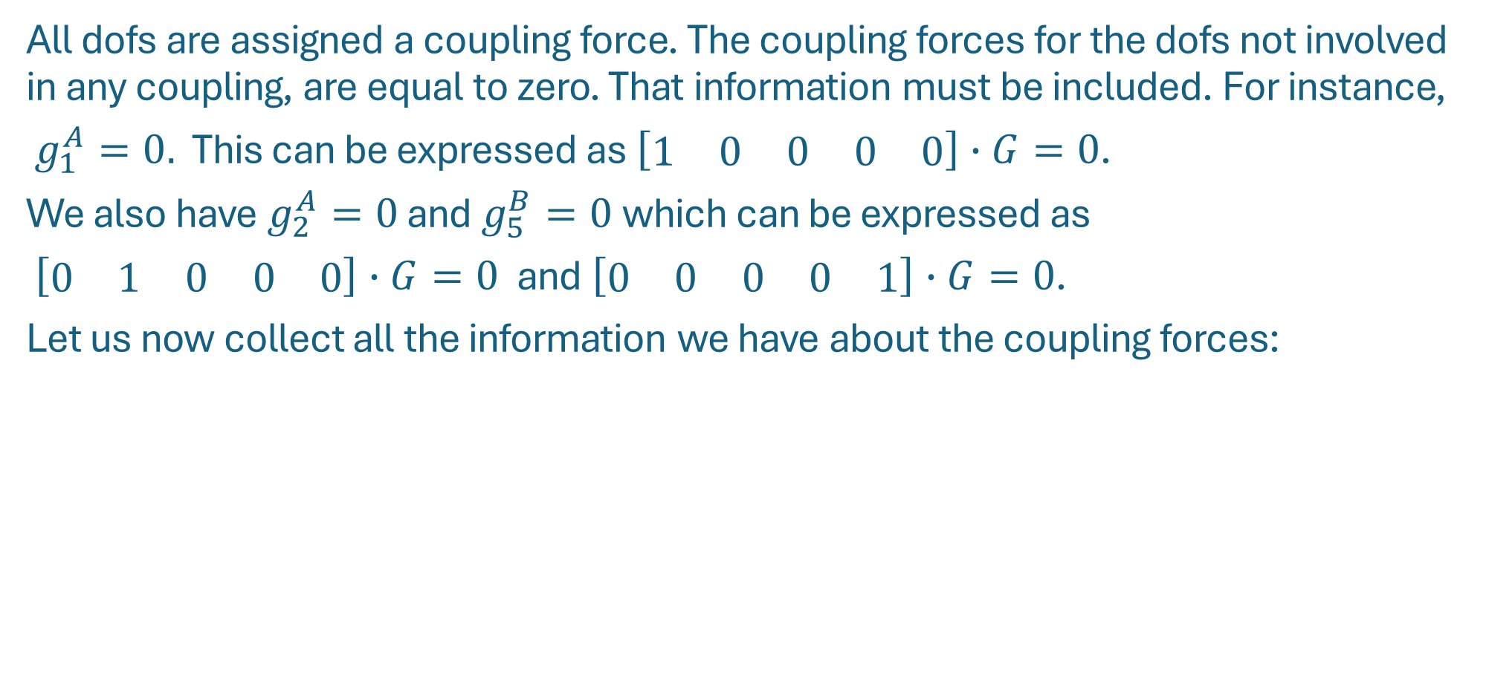

L transponate
All dofs are assigned a coupling force. The coupling forces for the dofs not involved in any coupling, are equal to zero. That information must be included. For instance,
$g_{1}^{A}=0.$ This can be expressed as $\left[\begin{matrix}\begin{matrix}1 & 0\end{matrix} & \begin{matrix}0 & 0 & 0\end{matrix}\end{matrix}\right]∙G=0$.
We also have $g_{2}^{A}=0$ and $g_{5}^{B}=0$which can be expressed as
$\left[\begin{matrix}\begin{matrix}0 & 1\end{matrix} & \begin{matrix}0 & 0 & 0\end{matrix}\end{matrix}\right]∙G=0$ and $\left[\begin{matrix}\begin{matrix}0 & 0\end{matrix} & \begin{matrix}0 & 0 & 1\end{matrix}\end{matrix}\right]∙G=0$.
Let us now collect all the information we have about the coupling forces:
$$\left[\begin{matrix}1 & 0 & \begin{matrix}0 & 0 & 0\end{matrix} \\ 0 & 1 & \begin{matrix}0 & 0 & 0\end{matrix} \\ \begin{matrix}0 \\ 0\end{matrix} & \begin{matrix}0 \\ 0\end{matrix} & \begin{matrix}\begin{matrix}1 \\ 0\end{matrix} & \begin{matrix}1 \\ 0\end{matrix} & \begin{matrix}0 \\ 1\end{matrix}\end{matrix}\end{matrix}\right]∙\left\{\begin{matrix}g_{1}^{A} \\ g_{2}^{A} \\ \begin{matrix}g_{3}^{A} \\ g_{4}^{B} \\ g_{5}^{B}\end{matrix}\end{matrix}\right\}≜L^{T}∙G=0$$
where $L$ turns out to be the localization matrix.

Slide 13

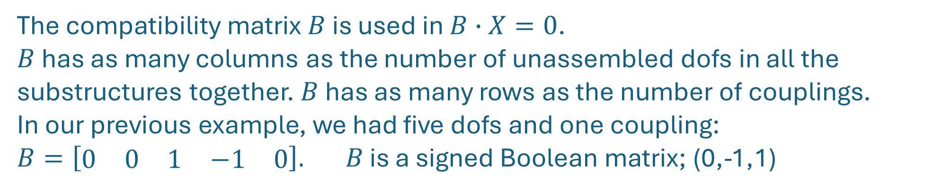
Some characteristics of B and L
The compatibility matrix $B$ is used in $B∙X=0$.
$B$ has as many columns as the number of unassembled dofs in all the substructures together. $B$ has as many rows as the number of couplings.
In our previous example, we had five dofs and one coupling: $B=\left[\begin{matrix}\begin{matrix}0 & 0 & 1\end{matrix} & \begin{matrix}−1 & 0\end{matrix}\end{matrix}\right]. B$ is a signed Boolean matrix; (0,-1,1)
The transpose of the localization matrix $L^{T}$ is used in $L^{T}∙G=0.$
$L^{T}$ has as many columns as the the number of unassembled dofs in all the substructures. $L^{T}$ has as many rows as; (the number of unassembled dofs in all the substructures)-(the number of couplings). We had five dofs and one coupling:
$L^{T}=\left[\begin{matrix}1 & 0 & \begin{matrix}0 & 0 & 0\end{matrix} \\ 0 & 1 & \begin{matrix}0 & 0 & 0\end{matrix} \\ \begin{matrix}0 \\ 0\end{matrix} & \begin{matrix}0 \\ 0\end{matrix} & \begin{matrix}\begin{matrix}1 \\ 0\end{matrix} & \begin{matrix}1 \\ 0\end{matrix} & \begin{matrix}0 \\ 1\end{matrix}\end{matrix}\end{matrix}\right]$ $L$ is a Boolean matrix; (0,1)

Slide 14

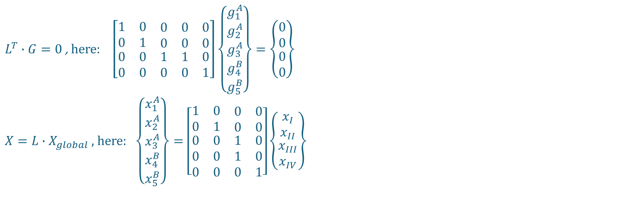

Some characteristics of B and L
$L^{T}∙G=0$ , here: $\left[\begin{matrix}1 & 0 & \begin{matrix}0 & 0 & 0\end{matrix} \\ 0 & 1 & \begin{matrix}0 & 0 & 0\end{matrix} \\ \begin{matrix}0 \\ 0\end{matrix} & \begin{matrix}0 \\ 0\end{matrix} & \begin{matrix}\begin{matrix}1 \\ 0\end{matrix} & \begin{matrix}1 \\ 0\end{matrix} & \begin{matrix}0 \\ 1\end{matrix}\end{matrix}\end{matrix}\right]\left\{\begin{matrix}g_{1}^{A} \\ g_{2}^{A} \\ \begin{matrix}g_{3}^{A} \\ g_{4}^{B} \\ g_{5}^{B}\end{matrix}\end{matrix}\right\}=\left\{\begin{matrix}\begin{matrix}0 \\ 0\end{matrix} \\ 0 \\ 0\end{matrix}\right\}$
$X=L{∙X}_{global}$ , here: $\left\{\begin{matrix}x_{1}^{A} \\ \begin{matrix}x_{2}^{A} \\ x_{3}^{A} \\ x_{4}^{B}\end{matrix} \\ x_{5}^{B}\end{matrix}\right\}=\left[\begin{matrix}1 & 0 & \begin{matrix}0 & 0\end{matrix} \\ 0 & 1 & \begin{matrix}0 & 0\end{matrix} \\ \begin{matrix}0 \\ 0 \\ 0\end{matrix} & \begin{matrix}0 \\ 0 \\ 0\end{matrix} & \begin{matrix}\begin{matrix}1 & 0\end{matrix} \\ \begin{matrix}1 & 0\end{matrix} \\ \begin{matrix}0 & 1\end{matrix}\end{matrix}\end{matrix}\right]\left\{\begin{matrix}x_{I} \\ x_{II} \\ \begin{matrix}x_{III} \\ x_{IV}\end{matrix}\end{matrix}\right\}$
$$B∙X=B∙L{∙X}_{global}≜0$$
for all $X_{global}$ since global dofs are per definition compatible
Hence; $BL≜0$ or $L=$ null($B$)

Slide 15
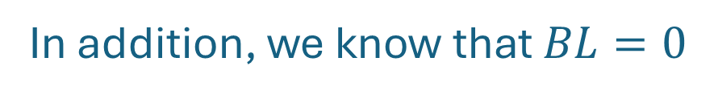
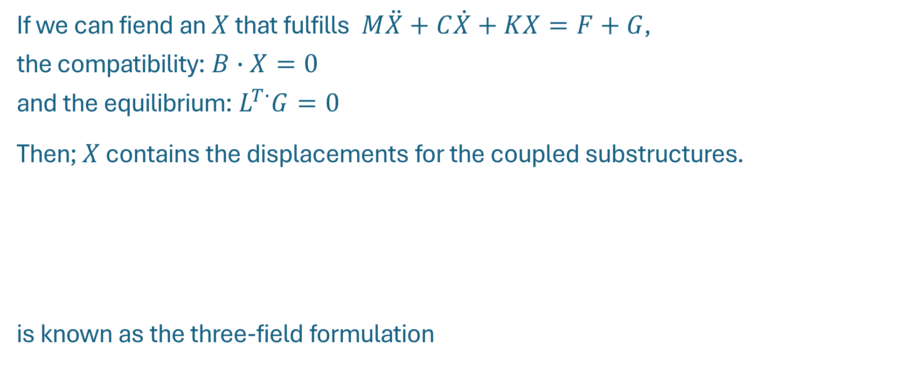
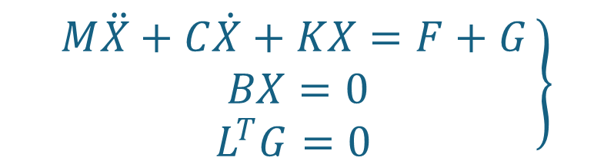
The three field formulation
If we can fiend an $X$ that fulfills $M\ddot{X}+C\dot{X}+KX=F+G$,
the compatibility: $B∙X=0$
and the equilibrium: $L^{T∙}G=0$
Then; $X$ contains the displacements for the coupled substructures.
is known as the three-field formulation
$$\left.\begin{matrix}M\ddot{X}+C\dot{X}+KX=F+G \\ BX=0 \\ L^{T}G=0 \end{matrix}\right\}$$
Dynamic equilibrium for each substructure on its own
Interface compatibility
Equilibrium
In addition, we know that $BL=0$

Slide 16
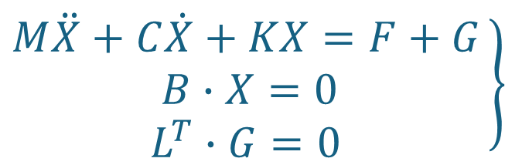


Coupling in the physical domain; the Primal assembly
Let us now use $X=L∙X_{global}$. Then:
$$\left.\begin{matrix}M\ddot{X}+C\dot{X}+KX=F+G \\ B∙X=0 \\ L^{T}∙G=0 \end{matrix}\right\}$$
$$\left.\begin{matrix}M∙L{∙\ddot{X}}_{global}+C∙L∙{\dot{X}}_{global}+K∙L{∙X}_{global}=F+G \\ L^{T}∙G=0\end{matrix}\right\}$$
$B∙X=0$ is naturally satisfied since $B∙X=B∙L{∙X}_{global}≜0$
Now: Pre-multiply the governing equation of motion with $L^{T}$. Then:
$L^{T}ML{\ddot{X}}_{global}+L^{T}CL{\dot{X}}_{global}+L^{T}KLX_{global}=L^{T}F+L^{T}G=L^{T}F$ , since $L^{T}G≜0$

Slide 17




Coupling in the physical domain; Primal assembly
With:
$$\tilde{M}=L^{T}ML$$
$$\tilde{C}=L^{T}CL$$
$\tilde{K}=$ $L^{T}KL$
$$\tilde{F}=L^{T}F$$
$\tilde{M}{\ddot{X}}_{global}+$ $\tilde{C}{\dot{X}}_{global}+\tilde{K}X_{global}=\tilde{F}$

Slide 18




Coupling in the physical domain; the Dual assembly
$$\left.\begin{matrix}M\ddot{X}+C\dot{X}+KX=F+G \\ BX=0 \\ L^{T}G=0 \end{matrix}\right\}$$
That is: $\left\{\begin{matrix}g_{1}^{A} \\ g_{2}^{A} \\ \begin{matrix}g_{3}^{A} \\ g_{4}^{B} \\ g_{5}^{B}\end{matrix}\end{matrix}\right\}=\left\{\begin{matrix}\begin{matrix}0 \\ 0 \\ 1\end{matrix} \\ −1 \\ 0\end{matrix}\right\}λ$
Let us now define $G={−B}^{T}Λ$
Then: $\left.\begin{matrix}M\ddot{X}+C\dot{X}+KX=F−B^{T}Λ \\ BX=0\end{matrix}\right\}$
Whereas, $L^{T}G=0,$is naturally satisfied since $L^{T}G=−L^{T}B^{T}Λ=−{\left(BL\right)}^{T}Λ≜0.$

Slide 19

Coupling in the physical domain; Dual assembly
Thus:
$\left[\begin{matrix}M & 0 \\ 0 & 0\end{matrix}\right]\left\{\begin{matrix}\ddot{X} \\ \ddot{Λ}\end{matrix}\right\}$+ $\left[\begin{matrix}C & 0 \\ 0 & 0\end{matrix}\right]\left\{\begin{matrix}\dot{X} \\ \dot{Λ}\end{matrix}\right\}+\left[\begin{matrix}K & B^{T} \\ B & 0\end{matrix}\right]\left\{\begin{matrix}X \\ Λ\end{matrix}\right\}=\left\{\begin{matrix}F \\ 0\end{matrix}\right\}$

Slide 20

Exercise:
System A
System B
$x_{1}^{A}$,$g_{1}^{A},$ $f_{1}^{A}$
$x_{2}^{A}$,$g_{2}^{A},$ $f_{2}^{A}$
$x_{3}^{A}$,$g_{3}^{A},$ $f_{3}^{A}$
$x_{5}^{B}$,$g_{5}^{B},$ $f_{5}^{B}$
Let: $m_{i}=1$ , $c_{i}=i$ , $k_{i}=10,000∙i$ , $f_{1}=1$ , $f_{2}=f_{3}=f_{4}=f_{5}=0$
Consider the structures to be coupled (one structure). Define the MCK matrices and the load vector
Now, look at the system as consisting of two substructures.
a) Define the block diagonal matrices and vectors
b) Define the compatibility matrix, B
c) Define the localization matrix, L
d) Define the three-field formulation
e) Calculate the matrices using the primal and dual assemblies
$x_{4}^{B}$,$g_{4}^{B},$ $f_{4}^{B}$

Slide 21
%--------------------------------------------------------------------------
% Substructure A
%--------------------------------------------------------------------------
%
MA=[m1 0 0;0 m2 0;0 0 m3];
CA=[(c1+c2) -c2 0;-c2 (c2+c3) -c3;0 -c3 c3];
KA=[(k1+k2) -k2 0;-k2 (k2+k3) -k3;0 -k3 k3];
%
FA=[1 0 0]';
GA=['g1';'g2';'g3'];
[rsubA,csubA]=size(MA);
%
%--------------------------------------------------------------------------
% Substructure B
%--------------------------------------------------------------------------
%
MB=[m4 0;0 m5];
CB=[c4 -c4;-c4 (c4+c5)];
KB=[k4 -k4;-k4 (k4+k5)];
%
FB=[0 0]';
GB=['g4';'g5'];
[rsubB,csubB]=size(MB);
%
% This is a small example on how to derive the %matrices using Substructuring Primal and Dual %Assemblies. Substructure A is a three degree-of %freedom system clamped at its left end and %substructure B is a two degree-of-freedom %structure clamped at its right end. The systems %are coupled in their free ends.
%
% 2026-01-12
% Andreas Linderholt, LNU
%------------------------------------------------------------ % Initialize
%------------------------------------------------------------
m1=1; m2=1; m3=1; m4=1; m5=1;
c1=1; c2=2; c3=3; c4=4; c5=5;
k1=10000; k2=20000; k3=30000; k4=40000; k5=50000;
%

Slide 22
%-----------------------------------------------------------
% Block diagonal matrices and vectors
%-----------------------------------------------------------
M=[MA zeros(rsubA,csubB);zeros(rsubB,csubA) MB];
C=[CA zeros(rsubA,csubB);zeros(rsubB,csubA) CB];
K=[KA zeros(rsubA,csubB);zeros(rsubB,csubA) KB];
F=[FA;FB];
G=[GA;GB];
%
%-----------------------------------------------------------
% The compatibility matrix, B
%-----------------------------------------------------------
B=[0 0 1 -1 0];
[rB,cB]=size(B);
%
%-----------------------------------------------------------
% The localization matrix, L
%-----------------------------------------------------------
L=[1 0 0 0;0 1 0 0;0 0 1 0;0 0 1 0;0 0 0 1];
%
%-------------------------------------------------------------------------
% The three field formulation
%-------------------------------------------------------------------------
% Mx_dot_dot+Cx_dot+K=F+G (1) Governing equation of motion
% Bx=0 (2) Compatibility
% L'G=0 (3) Equilibrium
%
%--------------------------------------------------------------------------
% Primal assembly
%--------------------------------------------------------------------------
% x=Lxglobal=Lxg (4)
% (4) in (1) and pre-multiply with L' ==>
% L'MLxg_dot_dot+L'CLxg_dot+L'KLxg=L'F+L'G
% using (3) ==> L'MLxg_dot_dot+L'CLxg_dot+L'KLxg=L'F
%
Mprimal=L'*M*L , Cprimal=L'*C*L , Kprimal=L'*K*L , Fprimal=L'*F
%

Slide 23
%-------------------------------------------------------------------------
% Dual assembly
%-------------------------------------------------------------------------
%
% G=-B'Lambda ==> (3) ==> L'(-B'Lambda)=-L'B'Lambda=-(BL)'Lambda==0
% (3) is, by the choice of G, fulfilled and (1)==>
% Mx_dot_dot+Cx_dot+K=F-B'Lambda ==> Mx_dot_dot+Cx_dot+K+B'Lambda=F
%
% With the displacement vector [x;Lambda] etc.:
%
Mdual=[M zeros(cB,rB);zeros(rB,cB) zeros(rB,rB)]
Cdual=[C zeros(cB,rB);zeros(rB,cB) zeros(rB,rB)]
Kdual=[K B';B zeros(rB,rB)]
Fdual=[F;zeros(rB,1)]

Slide 24





Coupling in the physical domain; summary
$$\left.\begin{matrix}M\ddot{X}+C\dot{X}+KX=F+G \\ BX=0 \\ L^{T}G=0 \end{matrix}\right\}$$
Three-field form
Primal
Dual
$\tilde{M}{\ddot{X}}_{global}+$ $\tilde{C}{\dot{X}}_{global}+\tilde{K}X_{global}=\tilde{F}$
$\left[\begin{matrix}M & 0 \\ 0 & 0\end{matrix}\right]\left\{\begin{matrix}\ddot{X} \\ \ddot{Λ}\end{matrix}\right\}$+ $\left[\begin{matrix}C & 0 \\ 0 & 0\end{matrix}\right]\left\{\begin{matrix}\dot{X} \\ \dot{Λ}\end{matrix}\right\}+\left[\begin{matrix}K & B^{T} \\ B & 0\end{matrix}\right]\left\{\begin{matrix}X \\ Λ\end{matrix}\right\}=\left\{\begin{matrix}F \\ 0\end{matrix}\right\}$

Slide 25







Coupling the physical model: Some remarks
When enforcing interface equilibrium and compatibility, we have assumed that the interface has no local dynamics:
If interface flexibility, damping or mass is present at the interface, then the interface conditions must be slightly altered
and modified primal and dual assembled systems can be derived.
If incompatible interfaces are present, other requirements
must be formed.
$$x$$
$$\left.\begin{matrix} \\ BX=0 \\ L^{T}G=0 \end{matrix}\right\}$$
$$g$$
$$\left.\begin{matrix} \\ BX≠0 \\ L^{T}G≠0 \end{matrix}\right\}$$
$$x$$
$$g$$

Slide 26
The physical domain so far:
Need access to the physical domain matrices.
- If our analysis is based on model data, it is all good
- Not useful for test data
We assume that the couplings take place in a (small)
number of discrete and known dofs.
We assume that the couplings themselves have no masses or stiffnesses.
Some domains that can be utilized:
the Modal domain (representation space)
the Frequency domain
the State-space domain
the Time domain (impulse responses)

Slide 27
Next Up: Frequency Based Substructuring

